Slide 1
Facts on Mobile Application Development
Thanks to Mohammed Alhusein

Slide 2
Outline
Competition
Development
Publishing
Native Vs. Cross-platform

Slide 3
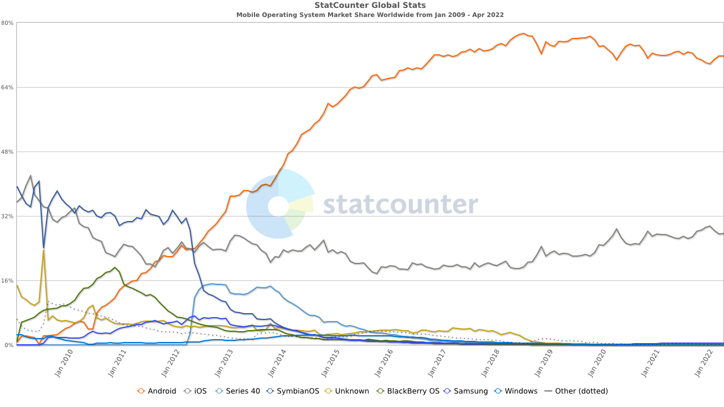
OS Market Share (World)

Slide 4
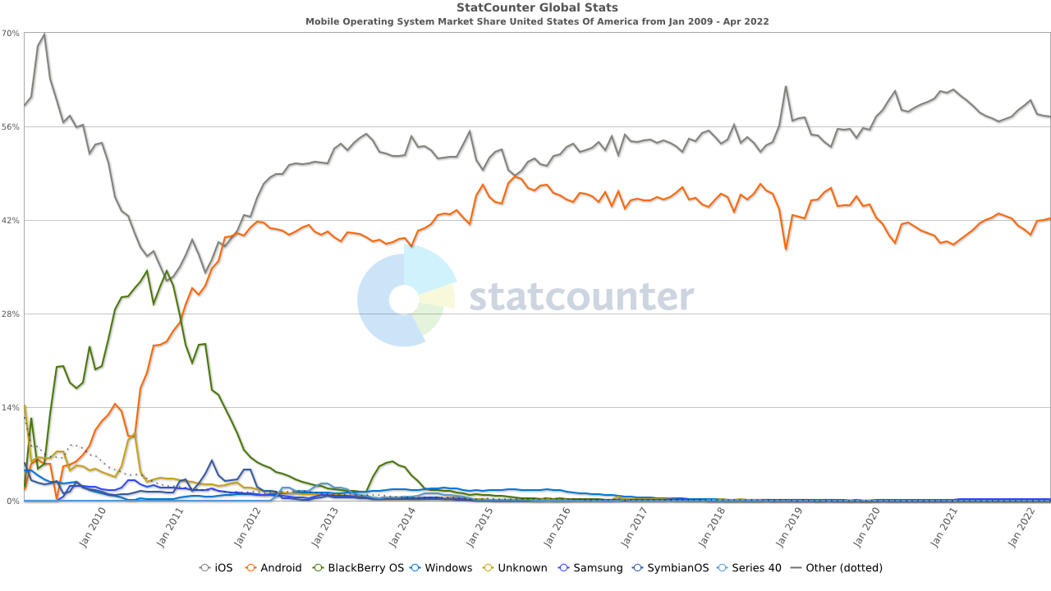
OS Market Share (USA)

Slide 5
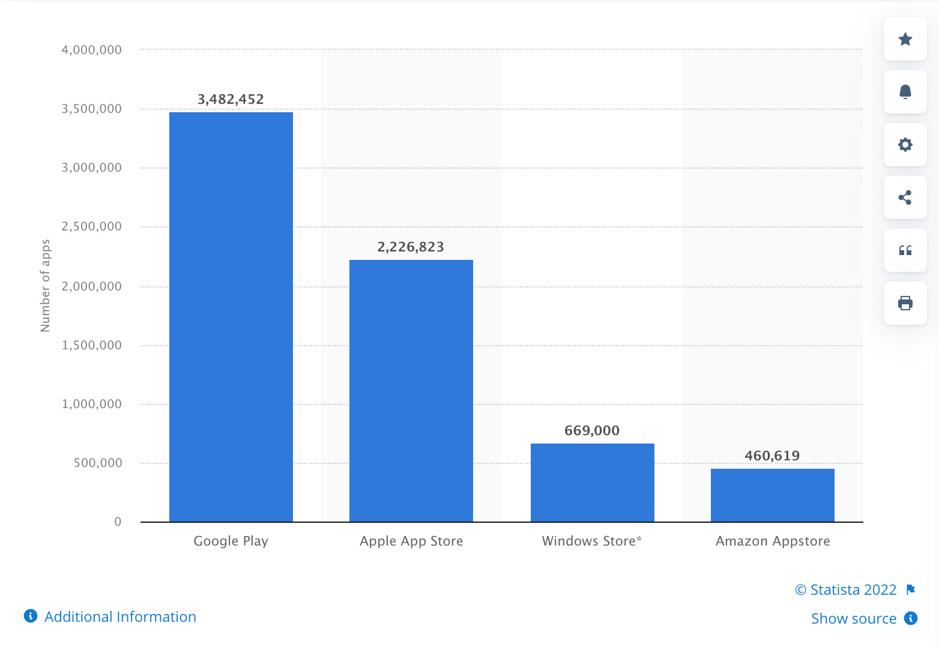
Number of apps available in leading app stores as of 1st quarter 2021

Slide 6
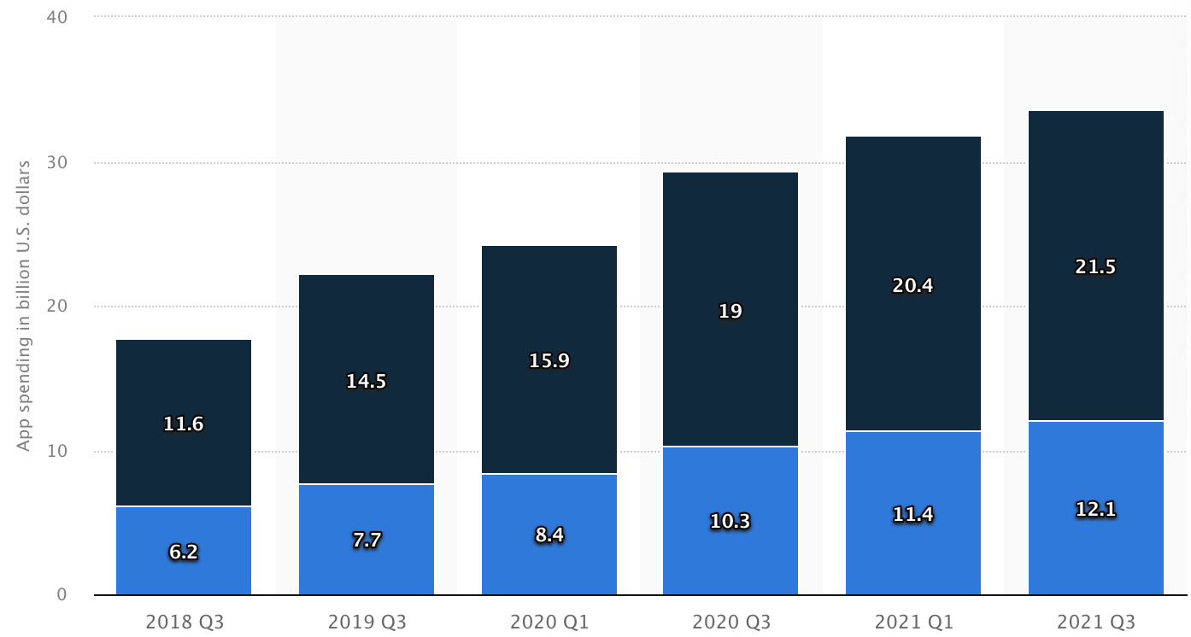
Worldwide consumer spending on mobile apps and games as of 3rd quarter 2021
Ease of purchase: Checkout vs. iTunes
93% iOS users have iTunes accounts with credit card info.
Google encourages free stuff.

Slide 7
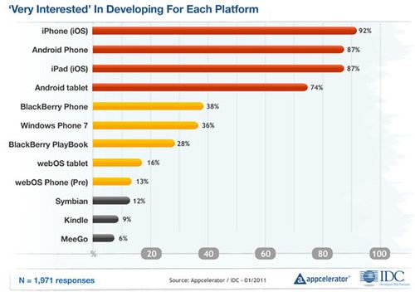
Developers’ Interest
https://mindsea.com/app-stats/
https://www.appdevelopmentcost.com/app-development-stats

Slide 8
Development

Slide 9
Programming Language
Android OS: Java, Kotlin
iOS: Objective C, Swift, SwiftUI

Slide 10
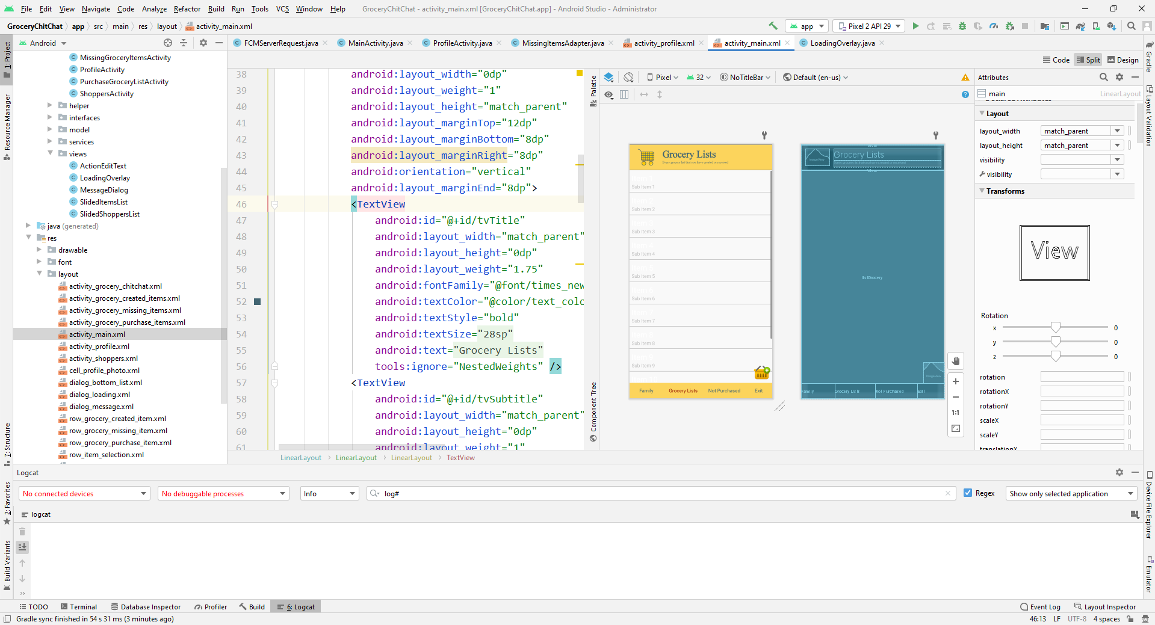
Layout Design: Android

Slide 11
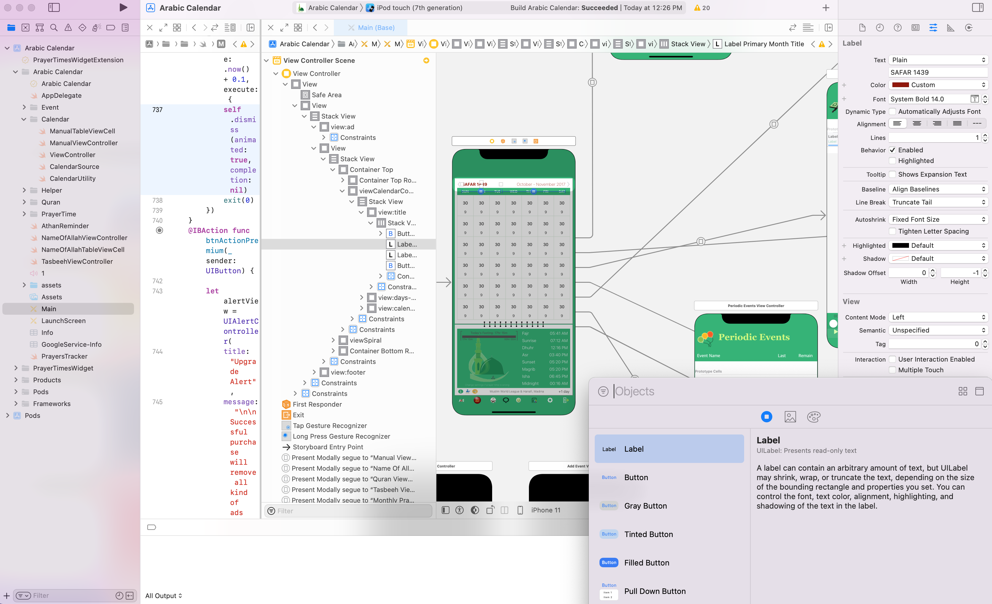
Layout Design: iOS

Slide 12
Development Platform
Android OS:
  open platform, allowing the use of 3rd party tools
  Key to OS success
  can reach core components. More like PC swr
iOS:
  Restrictive guidelines
  Fixed set of tools, nothing outside, nothing deep
  No Flash!

Slide 13
Multitasking Abilities
Android OS:
  Very versatile → dynamic
  Highly fragmented → challenging
    In USA: 80 Android models vs. 9 iOS models
  Poor battery performance
  Best notification system (e.g. emails)
iOS:
  Stable and exclusive platform
  Fixed set of tools, with clear potential and boundaries → easier

Slide 14
Security
Android OS:
  Access control, isolation, web security
  Encryption
  Permission-based access control:
    Static list in manifest
    User presented with list at installation time
  Wild West app marketplace.
    Nearly any app is allowed to market
    Android-specific malware

Slide 15
Security
iOS:
  Access control, isolation, web security
  Encryption
  Permission-based access control:
    Dialog box at run time.
  Geolocation
  Auto Erase

Slide 16
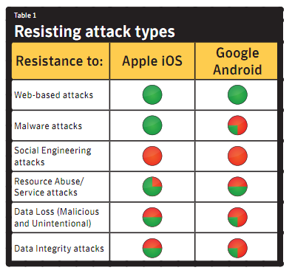
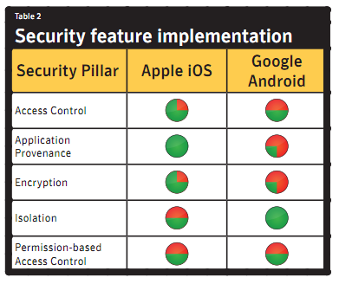
Security
Semantic

Slide 17
OS Upgrades
Android OS:
  Millions of phones under contract cannot be updated
  0.4% run the latest version
iOS:
  Apple disallows old devices to update →permanently vulnerable to easy attacks
  ~90% run one of the two latest versions

Slide 18
Publishing

Slide 19
App Approval
Android OS:
  Very quick! (compare to iOS)
iOS:
  Days.. and days.. and days..
  Many restrictions

Slide 20
Payments and Availability
Android OS:
  Developer pays $25 one time
  Developer earns 70% of revenue
  Several Stores: Google Play, Amazon…
  Paid apps available in 132 countries

Slide 21
Payments and Availability
iOS:
  Developer pays $100 annually
  Developers earns 70% of revenue
  App Store only
  Paid apps available in 155 countries

Slide 22


Which is Better?
OS Mkt Share
# of Apps
Revenue
Developer Interest
Easiness of PL
Platform
Multitasking
Security
OS Upgrades
App Approval
Payments & Avail.

Slide 23
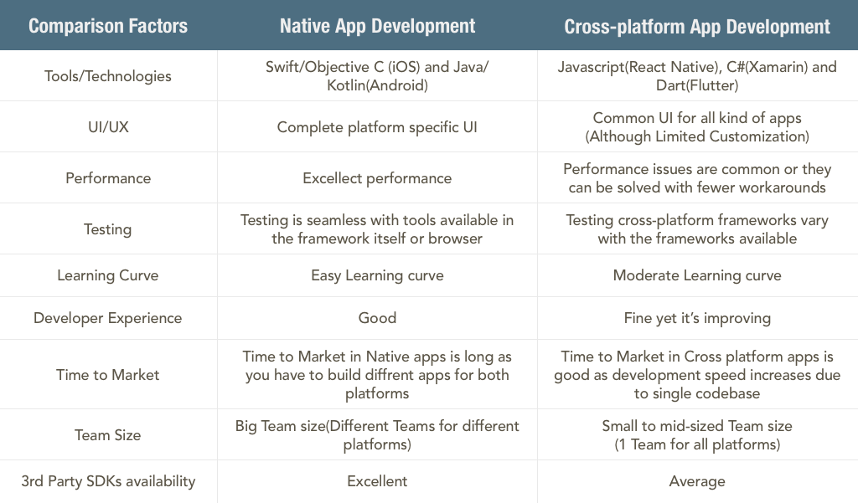
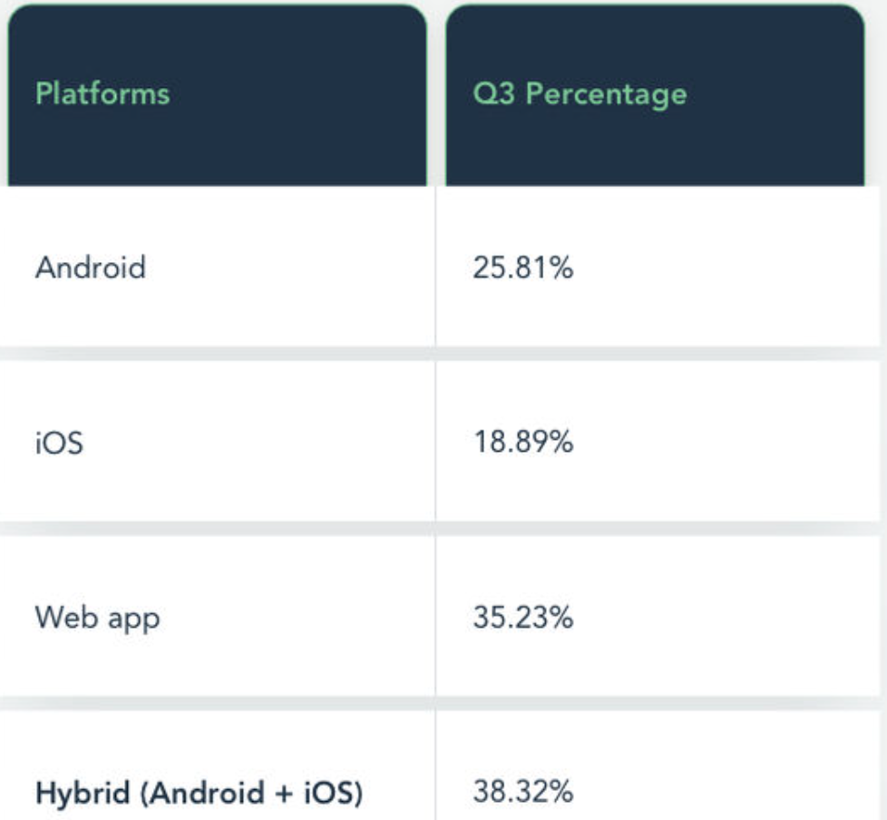
Native Vs. Cross-platform
70% of customers say they have abandoned their shopping carts because of a bad user experience
90% of smartphone users say they’re more likely to keep shopping if they’re having a great user experience.
https://www.simform.com/blog/native-vs-cross-platform-development/
https://www.netsolutions.com/insights/native-vs-hybrid-vs-cross-platform/

Slide 24
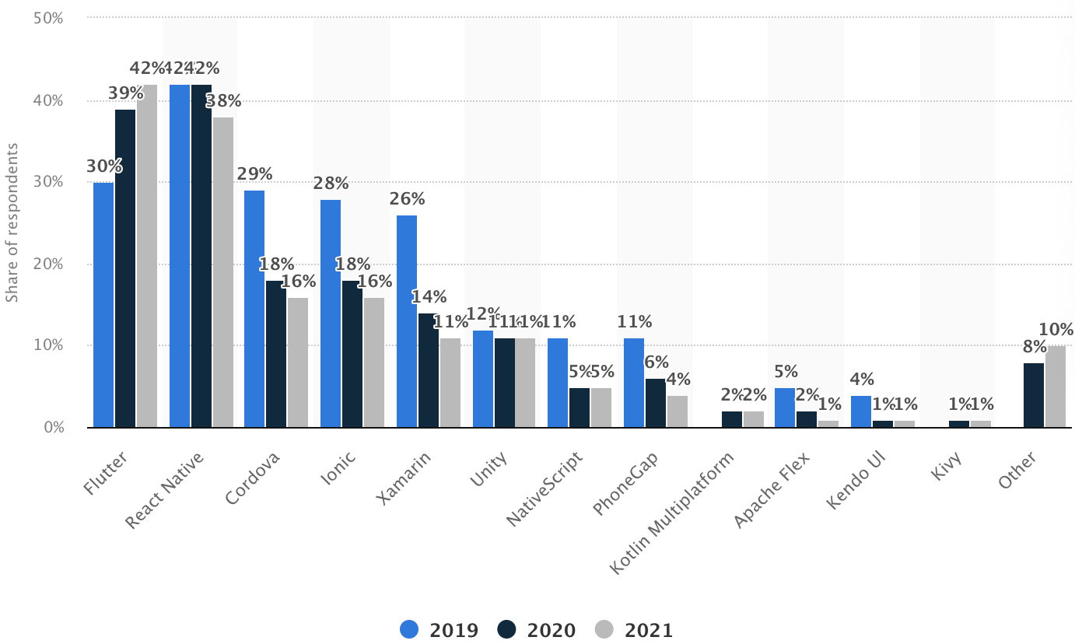
Cross-platform mobile frameworks used by software developers worldwide from 2019 to 2021
https://mindsea.com/app-stats/
https://www.appdevelopmentcost.com/app-development-stats

Slide 25

Sources
http://www.technolog.msnbc.msn.com/technology/technolog/android-iphone-its-two-horse-race-125203j
http://gs.statcounter.com/#mobile_os-ww-monthly-201106-201206
http://mobiledevices.about.com/od/kindattentiondevelopers/tp/Android-Os-Vs-Apple-Ios-Which-Is-Better-For-Developers.htm
http://www.wired.com/gadgetlab/2011/12/ios-revenues-vs-android/
http://www.callingallgeeks.org/34829/android-vs-ios-pros-and-cons/
http://www.lunawebs.com/blog/2012/03/18/android-vs-ios-the-pros-and-cons-of-two-app-platforms-825/
http://www.techtricksworld.com/2011/11/choosing-between-android-and-ios-a-developer%E2%80%99s-guide.html’
http://techsbot.com/android-vs-ios-pros-and-cons/
http://www.youtube.com/watch?v=OvdjXZnbC-o

